Slide 1
Update on Wirral Statement of Action for SEND
For:
Parents and carers
Children and young people
Stakeholders, partners, employees

Slide 2
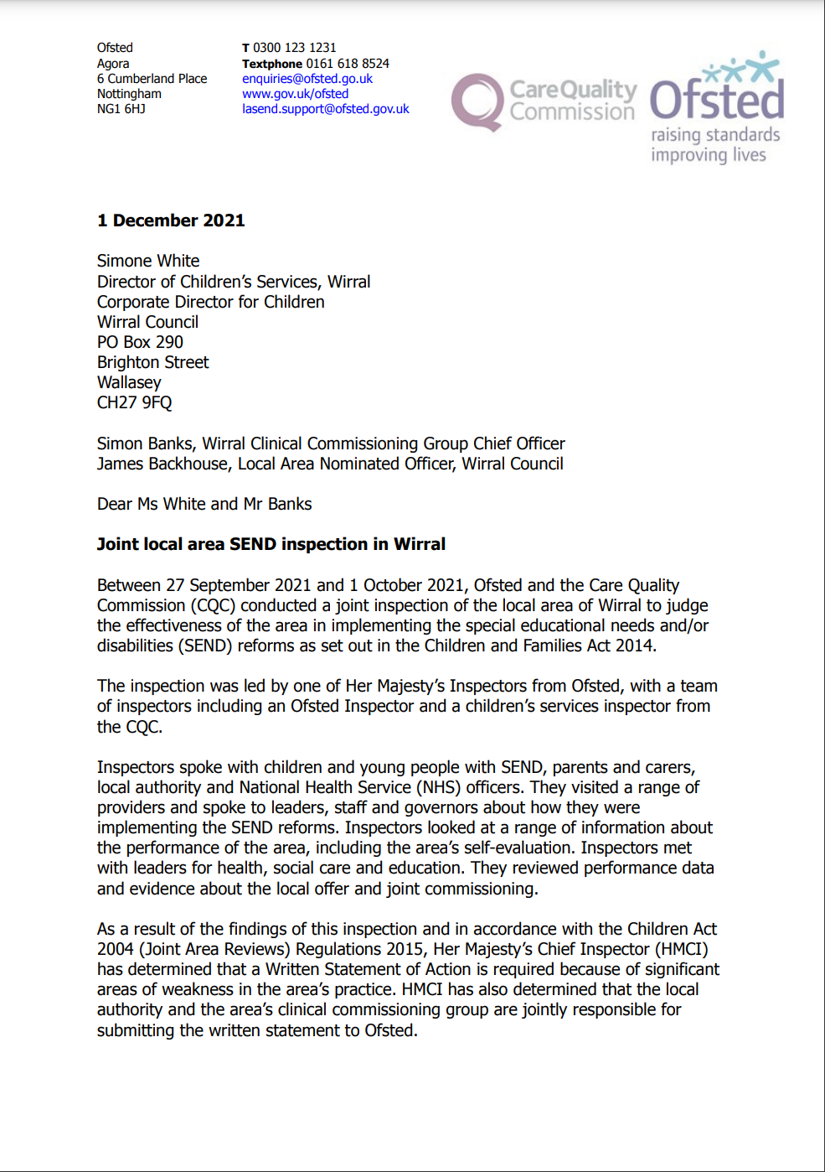
About the local area SEND inspection.
In September 21, the local area, which includes the council, schools and health services was inspected by Ofsted and the Care Quality Commission (CQC).
The inspection looked at services and support for children and young people with SEND.
After the inspection, Wirral local area was asked to produce a ‘Written Statement of Action’ to address the problems that had been identified during the inspection.

Slide 3
What is the Wirral Statement of Action?
The Wirral Statement of Action is an action plan which sets out the local areas plan to make changes and improve.
It includes ways in which it can demonstrate that progress has been made. For example, a higher number of Education, Health and Care Plans being completed within 20 weeks.
Wirral’s Statement of Action has been developed from several workshops which included key council officers, education, health and parent/carer and young people representatives.
On 29 March it was approved by Ofsted on behalf of Ofsted and CQC.

Slide 4
What’s happened so far?
A SEND Transformation Board has been set up with directors from the council and CCG, parents and carers and workstream leads.
Each workstream lead has set up a sub-group or outlined a plan for how they will deliver the actions within their workstream
A communication plan is in development to make sure that parents and carers, young people and employees are updated and informed of progress

Slide 5
Delivering the Wirral Statement of Action…
How will we deliver the
Workstream 1
Data Analysis & Joint Commissioning
Workstream 2
EHCP’s and Annual reviews
Workstream 3
Co-production, relationships, communication
Workstream 4
Inclusive Practices
Workstream 5
Local provision and strategic oversight
Workstream 6
Local Offer
Who is leading on this?
Jason Oxley, Assistant Director, Care and Health and Commissioning for People, Wirral Council
Carly Brown, Assistant Director, Strategy and Partnerships (People), Wirral Council
Elizabeth Hartley, Assistant Director Early Help and Prevention, Wirral Council
James Backhouse, Assistant Director Education, Wirral Council
Richard Crockford, Deputy Director Patient Safety and Quality, Wirral CCG
Mike Chandler, Assistant Director for Communication, Wirral CCG
What arrangements have been put in place?
Two sub-groups
Joint commissioning
Data analysis
Sub-group
This will cut across all workstreams
Sub-group has been established
Will be delivered through existing sub-groups
Sub-group has been set up

Slide 6
What progress has been made?

Slide 7
Workstream 1: Data analysis and joint commissioning
Progress
Health and local authority partners have agreed data to be shared
A review of what data is available is underway
Parents and carer survey has been carried out to see what is important to look at
A joint commissioner has been appointed to lead joint commissioning work
A draft Joint Strategic Needs Assessment has been completed
Next steps
Launch survey with parents and carer of speech and language – this survey is attached
Understand current joint commissioning picture and start to agree programme
Analyse parent/carer survey to inform new data dashboard

Slide 8
Workstream 2: EHCPs and Annual reviews
Progress
EHCP compliance checklist and quality standards have been produced
Sub-groups and communication arrangements with SEND managers in place
Next steps
Identify key pressures across service and report to SEND Transformation Board
Produce EHC flowchart and publish on local offer site
Review caseloads of co-ordinators and produce data management report to monitor performance

Slide 9
Workstream 3: Co-production, relationships and communication
Progress
Parent Carer Participation Wirral (PCPW) have been identified as members of the Transformation Board
Increased face-to-face and online engagement with parents/carers of Wirral’s SEND children
Next steps
A public engagement event to be scheduled
A co-production plan for the Wirral Statement of Action to be outlined

Slide 10
Workstream 4: Inclusive practices
Progress
A new early intervention team has been established to support universal offer in schools and to help with early support for children and young people
Engagement has taken place with headteachers and SENCOs to better understand training needs
Next steps
Develop training plan for local area to support school staff and SENCO’s
Collate feedback from professionals who have reviewed school practice to identify areas of strength

Slide 11
Workstream 5: Local provision and strategic oversight
Progress
An internal review has commenced to understand detailed information about 20 complaints and why they have been made.
Four new inclusion bases have been commissioned – these will have performance indicators and be monitored to ensure quality practice
Next steps
Match the health services data with existing data
Set up a tribunal sub-group to review outcomes of complaints and tribunals

Slide 12
Workstream 6: Local offer
Progress
Research of other local offer sites has commenced
Members for working group identified and meeting arranged
Next steps
Secure agreement from key people to inform new local offer
Confirm finance and commissioning arrangements
Identify Named officer for content

Slide 13
What is Parent Carer Participation Wirral saying? (the Parent/Carer Forum)
“PCPW understand for parent, carers, young people and children that nothing seems to have changed or improved since the inspection and we know there is a lot of frustration in the local SEND community regarding this.
PCPW are aware and involved in significant work being undertaken by the Local Area.
We are hopeful that everyone will start to see changes soon. PCPW are working hard to ensure that the Parent Carer voice is heard, listened to and acted upon.” PCPW

Slide 14
Your feedback…

