Slide 1
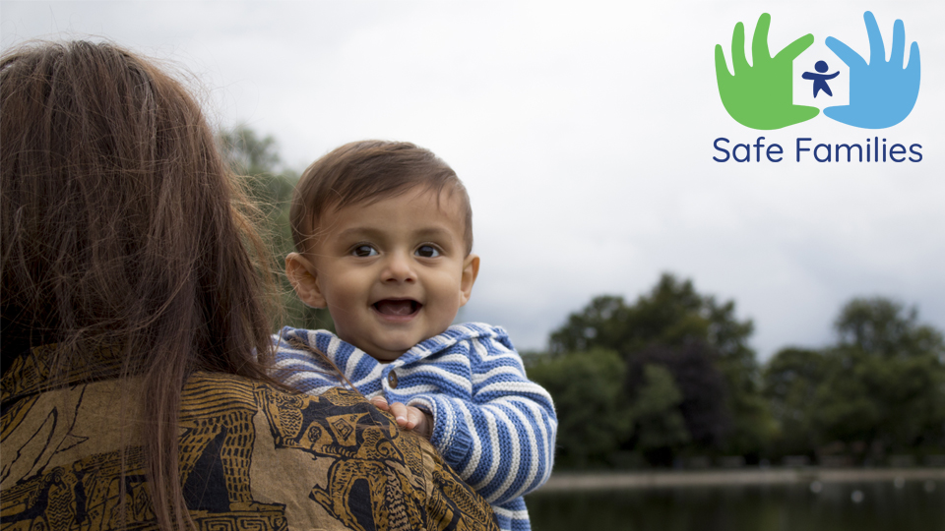

Slide 2
Who are we?
We exist to create relationship and connection because everyone deserves to belong.
Safe Families offer hope, belonging and support to children, families and care leavers; we do this primarily, but not exclusively, with and through local churches.
Notes:
Safe Families why and what from the playbook document

Slide 3
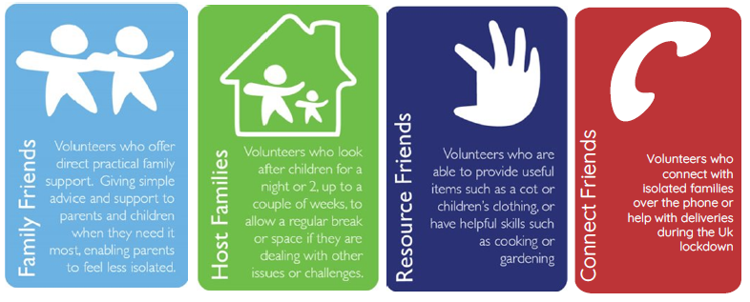
Ways to Volunteer
Notes:
Ways to make a difference

Slide 4
Volunteer process
Approval
Training
STEP 6
Safe Families review panel:
DBS complete
Assessor report
References
Sign volunteer agreement
Application
STEP 4
Attend Safe Families volunteer training day
STEP 1
Complete volunteer application form
STEP 5
121 assessment with Safe Families staff member
STEP 2
Make an online DBS application
STEP 7
Receive letter of approval & ID badge
Await first assignment
Home Safety Check for Host Families
STEP 3
Three personal references

Slide 5
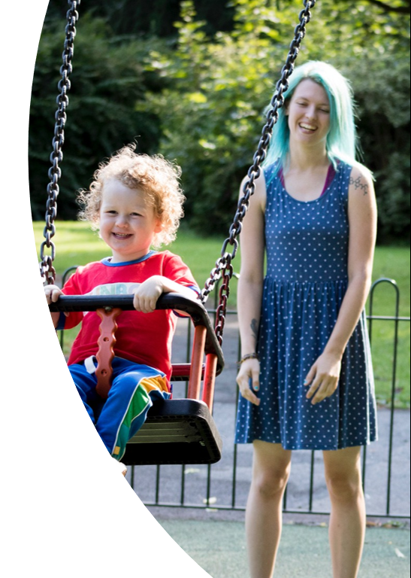
Core Criteria
Support parents, carers or children individually or as the entire family
Children aged 0-19
Parents/Carers in control – families not obligated to engage this is voluntary
Support may cover overnight hosting, daytime respite, mentoring, befriending

Slide 6
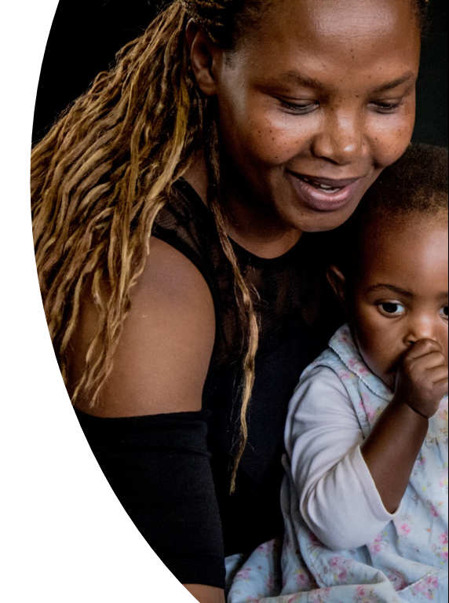
Core Criteria
Support plans are established with each family and referrer informed of progress
All circumstances covered as long as safe and appropriate for volunteer involvement
Support generally lasts 3 to 6 months but may be extended, if appropriate

Slide 7
Terminology:
Making a request for support
Leaflets are available for families
Call to discuss support call 0151 334 4473
All hosting requests to go via the AGM – to book a slot on a Monday please liaise with Leonni Robinson
Can be discussed internally with Gatekeeper yet to be confirmed in Wirral(?)

Slide 8
Making a request for support
Link to submit details of request refer.safefamilies.uk
Family will be visited and support plan developed
Volunteer identified and introduced to family

Slide 9
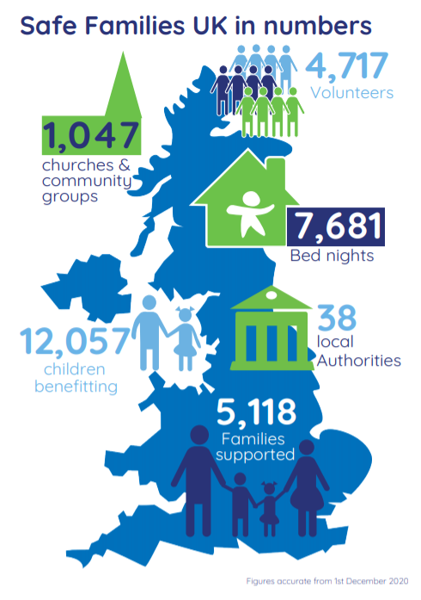
Impact
Notes:
Impact Slide – infographic

Slide 10
Hosting
7,681 Bed Nights of Hosting
=
21 Years of Hosting

Slide 11
Impact North West
789 volunteers (and 48 in training)
163 families currently being supported (1357 in total)
363 children currently being supported (3279 in total)
1793 bed nights provided

Slide 12
Impact
3 families connected with volunteers every single day
96% of families say their social networks are maintained or improved
94% of parents say their confidence has been maintained or improved
Notes:
Impact Slide – key stats

Slide 14
Volunteer
We are always looking for volunteers who have life skills!
Support can be once a week for an hour/ or twice a month maybe overnight hosting or befriending
Do you know of anybody who would be interested in volunteering or indeed are you?
Always happy to have a chat or discuss
THANK YOU volunteer.safefamilies.uk

Slide 15
Connect with us
sarahbroadbent@safefamilies.uk
safefamilies.uk
​
@safefamiliesuk
​
@SafeFamiliesuk
Notes:
Connect with us – personalise with local email contact

