Slide 1
SEND Training and Information for Headteachers and SENCO’s Friday 13th February
February

Slide 2
Purpose of the session.
Support schools with the implementation of the SEND Code of Practice Guidance
Provide clarity re SEN processes within the LA
Understand the ‘outcome’ focussed nature of the reforms
Answer some frequently asked questions
Identify future development and training needs

Slide 3
What has prompted all the changes in the SEN System?
The Children and Families Act 2014
“Our vision for children and young people with special needs is the same as for all children and young people – that they achieve well in their early years, at school and in college; lead happy and fulfilled lives.” (DfE)

Slide 4
Overview of SEND Support
ASP’s / School SEN support
(replacing School Action / School Action Plus)
SEN support – Graduated Approach
PCP Plans
High quality teaching differentiated for all pupils
EHCP’s
Special Education Provision
Element 1 + 2 + 3
(3.1% of Wirral population, 2.8% of population in England)
Element 1 + 2
(20% of Wirral population, 17.9% of population in England)
Education Provision that is ordinarily available
Element 1

Slide 5
What is the difference between a Statement and An Education, Health and Care Plan?
EHCP’s - same statutory protection as a statements, but include details of education, health and social care needs and provision
EHCP- follow an Integrated Assessment Process
EHCP- provide the offer of a Personal Budget
EHCP -covers from 0-25
EHCP- a more holistic and person centred plan
EHCP- is based on OUTCOMES
L.A- is legally responsible for the all parts of plans

Slide 6
Have the criteria for needing an E.H.C.P changed?
No –The legal test of when a child or young person requires an EHC plan remains the same as that for a statement under the Education Act 1996

Slide 7
What is the criteria for needing an EHCP Plan?
A child or young person has SEN if they have a learning difficulty or disability which calls for special educational provision to be made for them.
A child of school age has a learning difficulty or disability they;
Have a significantly greater difficulty in learning than the majority of children the same age
OR…..
A disability which prevents or hinders them from making use of facilities of a kind generally provided for others of the same age in mainstream schools/settings

Slide 8
What are the Key Questions to ask regarding eligibility?
How significant is the Learning difficulty or Disability?
What Provision is required to meet the need?
Is that provision ordinarily available?
Is it necessary for the LA to do an assessment/issue an EHCP in order to provide any additional resources?

Slide 9
What is SEN Provision?
SEN Provision is “education or training which is additional to /different from that which is made for other children of the same age in mainstream schools/settings.”-That which is not ordinarily available.

Slide 10
When should schools request an EHCP needs assessment?
“When despite having taken relevant and purposeful action to identify, assess and meet the SEN of the child or young person, the child or young person has not made the expected progress - the school with the parents should consider requesting an EHCP needs assessment.”C.O.P 2014
When schools have tried all the resourses available to them through their element 1 and 2 funding

Slide 11
Do schools need to have had E.P involvement in order to request an EHCP assessment?
In most cases children who have such significant needs which call for Specialist provision and will be known to the school Educational Psychologist

Slide 12
How do schools request an EHCP needs assessment?
If schools are considering making a request they should hold a multi agency meeting to review the impact of the provision supplied
If the feeling is that the child has not made expected progress…
Schools should fill out an SNR 1 form and attach the appropriate paperwork.
SNR 1 forms are available on WESCOM

Slide 13
What do schools need to send in with requests for an EHCP assessment?
To inform its decision on whether to initiate an assessment the L.A will expect to see evidence of the action taken by the school as part of SEN support
Currently this will need to include;
An Additional Support Plan (ASP) which has been reviewed OR
the following documents…

Slide 14
The following documents…
Child’s One Page Profile
Views and Aspirations of: Child/young person, Parent, School
Record of Progress Toward Agreed Outcomes
Basic Skill Achievements, Levels of Development/Progress, Standardised Test Results
Costed Provision Map
Special Educational Needs (Cognition and Learning/Communication and Interaction/Sensory and Physical/Social, Emotional, Mental Health)
Any Additional Significant Factors; Health, Attendance, Home Circumstances, Social Relationships
Relevant Health and Social Care Needs
Review of Current Interventions; Provision and Plan, Current plan and Last Two evaluated Plans
Details of any other Professionals Involved with Supporting Documents.

Slide 15
What is an Additional Support Plan?
A non statutory document, co-produced and intended to support schools recording all the important information for a child/young person in one place. It is person centred and focuses on outcomes.
Important information will include the success any targeted intervention has had in moving the child towards their outcomes
This targeted intervention must be costed if the ASP is being used as part of a request for Assessment.
Is there an Early Years ASP? Yes, available on WESCOM.
The ASP is currently under review.

Slide 16
Which children would benefit from an Additional Support Plan?
Children who were previously at School Action and School Action Plus
It is not just for those children/young people for whom an EHCP may be necessary

Slide 17
What should schools include in the “costed provision" part of an A.S.P?
Any provision or specialist resource which has been made available through the use of schools element 2 funding
It should not include provision such as SENCO time, EP time which is ordinarily made available through schools budgets and Local Authority/central Services

Slide 18
Do schools always have to put in two terms of support?
In a very small number of cases..
Such as: “When a child/ young people have such significant needs that the school considers it impossible or inappropriate to carry out its full assessment procedure without immediate specialist assessment/ interventions, which it is unable to provide, then a request for assessment without the two terms of provision being put in place can be made.”
Examples from the Code include “severe sensory impairment which without immediate specialists intervention would lead to increased learning difficulties”.

Slide 19
Has the EHCP pathway been revised? Why?
Yes, as with any new system we have sought views and focussed on good practice and amended the initial part of the pathway.
The majority of the pathway follows the timeline identified in the code of practice.

Slide 20
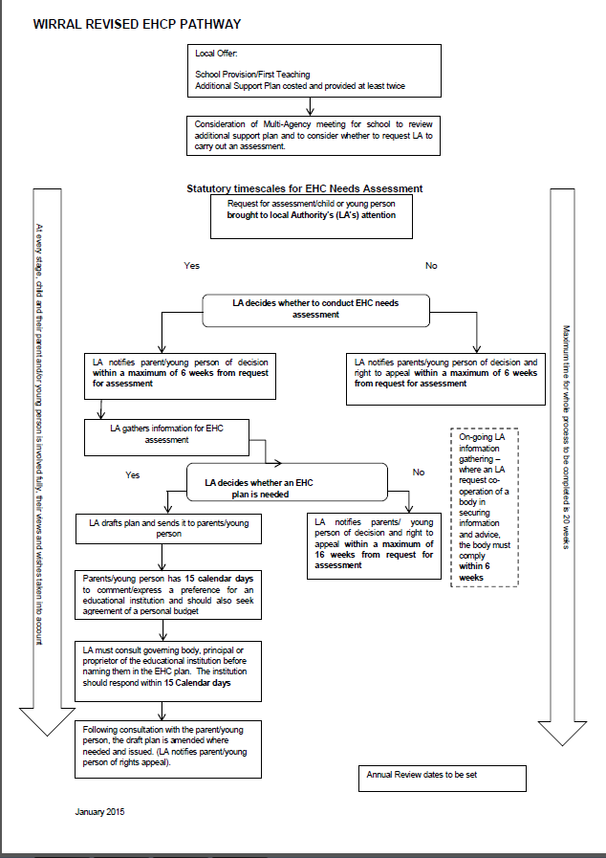
What does the revised EHCP pathway look like?
What is the main change?
Why was it changed?
What does that mean for schools?

Slide 21
What about the “multi agency Meeting”?
It is considered good practice for schools to hold review meetings to assess a child's progress and inform future planning, following targeted intervention.
Schools should remember that partnership and participation is at the heart of the reforms and this is a way to ensure that the child or young person remains at the centre.
Multi agency meetings should be a key part of the EHCP Process. However, the timing and purpose of them will be depend on the case.

Slide 22
Will the SNAP Panel carry on?
No –the panel will be replaced by the S.E.N. Decision Making Group
Currently, the group will meet fortnightly
The group will include Special Heads, Mainstream Heads, a Health rep and a Social Care rep …
The purpose of the group is to make decisions whether to agree to an EHCP Assessment and decide, following assessment, whether an EHCP is required and what provision is needed to meet the agreed outcomes.
There will also be a Moderation Group which will meet termly in order to ensure consistent decisions are being made.

Slide 23
What about children receiving Element 3 funding through I.P.F.A’s or I.H.C.P’s?
There are no plans to change these arrangements at this point.
The paperwork has been amended, it will put out for consultation and will be available soon on The Local Offer.
In the meantime –schools should continue to use existing paper work

Slide 24
What about children who remain on Statements?
Local Authorities have until April 2018 to transfer all existing Statements of Educational Need to Education Health and Care Plans(Wirral-1,600).
Until that point existing Statements will be maintained under the current arrangements.

Slide 25
Is there new Annual Review Paperwork?
Yes, the Local Authority has developed new formats to support schools recording information gathered at these meetings. Available on The Local Offer.

Slide 26
How will all the existing Statements get Transferred into EHCP’s?
LA’s must determine when children will be transferred to the new system
They must develop and publish these arrangements in a Local Transitional Plan.
To ensure momentum and manage the workload transfers should be done at points in the child's education at which a significant review of the statement would otherwise have taken place (transition points)
The transfer process should take 18 weeks from start to finish

Slide 27
The SEN Team will…
Provide schools with a list of C/Y.P who will transfer in this academic year.
Write to parents of C/Y.P who will have a transfer review in place of an Annual Review this academic year (a copy of this letter will be sent to the schools).
Provide schools with suggested template letters to send to parents/professionals to invite them to attend the Transfer Review Meeting.
Provide schools with new paper work for them to complete after/during the Transfer Review.

Slide 28
The E.H.C.P Co-ordinator will…
Agree dates for all the Transfer Reviews in each of their schools
Attend all the Transfer Reviews
Identify having attended the meeting, that there was an agreement that there is sufficient information to complete the EHCP assessment, and if not, what additional information is required.
Decide, having completed the assessment ,whether an EHCP is required.
Draft and issue the EHCP-following the usual processes.

Slide 29
The School will..
Arrange and chair the transfer review meeting, giving people invited at least two weeks notice.
Inform all invited attendees that they must provide up to date advice on their involvement or their most recent advice ,confirming that it remains appropriate. (whether they attend or not)
Help parents complete the Parent Contribution Form if needed.
Complete the Transfer Review Paper work and send it to the Co coordinator within two weeks of the meeting.

Slide 30
Who chairs the Transfer Review Meeting?
Schools are best placed to run the Transfer review meeting as they know the child/young person and their family best .
“Reviews led by the school will engender the greatest confidence amongst the child, young person and their family”

Slide 31
How do schools know how to run a Transfer Review Meeting?
Guidance for running these meetings is available on The Local Offer.
It is comprehensive and has prompts of what schools need to do before, during and after the meeting
This format worked well for the recent Year 6 Transfer Reviews

Slide 32
Will we follow the same Annual Review schedule?
No, Transfer Reviews will need to be done under the transfer review timetable.
Annual Reviews should be done following the schools normal procedures.
Please can EHCP Co-ordinators be part of this planning.

Slide 33
What about Personal Budgets?
Personal Budgets can be used to deliver agreed provision and meet agreed outcomes within an EHCP.
They provide creative solutions to individual requests.
The Wirral Policy is available on the local offer.

Slide 34
Will there be a New SEN Handbook/Toolkit?
We will put all the new paper work when it has been agreed in a document for schools
In the meantime single documents will be available on The Local Offer

Slide 35
Where can schools find out more about their responsibilities?
There is no replacement for reading the Code Of Practice
Schools; guide to the 0-25 SEND code of practice
The Equality Act 2010
Supporting pupils at school with medical conditions 2014

Slide 36
Final Thoughts…
“No decision about me without me”
“Plans are promises to children”
Julia Hassall-Director of Children and Young People’s Department

